Slide 1
BIO104
BIOLOGICAL TECHNIQUES

Slide 2
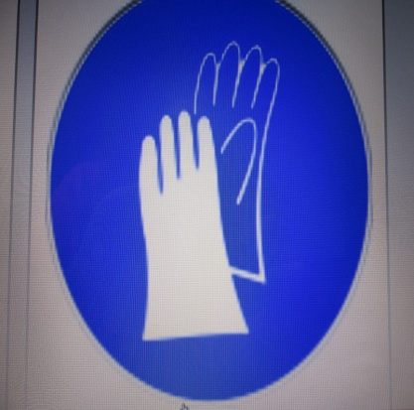
LABORATORY HAZARD SYMBOLS AND MEANINGS
GLOVES REQUIRED

Slide 3
BIOHAZARD

Slide 4
HIGH VOLTAGE

Slide 5
HOT SURFACE

Slide 6
LOW TEMPERATURE

Slide 7
LASER BEAM HAZARD

Slide 8
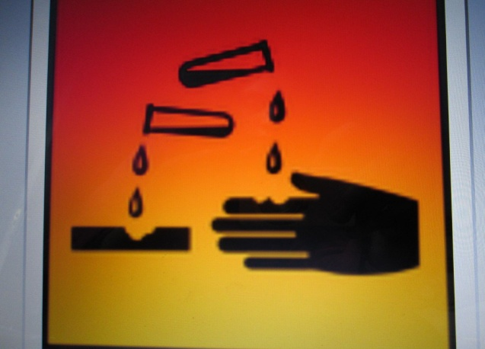
CORROSIVE

Slide 9
DANGEROUS TO THE ENVIRONMENT

Slide 10
FLAMMABLE

Slide 11
IRRITANT

Slide 12
POISON

Slide 13
EXPLOSIVE MATERIAL HAZARD

Slide 14
CHEMICAL WEAPON

Slide 15
ELECTRICAL HAZARD

Slide 16
GLASSWARE HAZARD

Slide 17
CARCINOGEN HAZARD

Slide 18
LABORATORY GLASSWARE

Slide 19
Erlenmeyer flask (conical flask)
Used for titration or filtration of liquids and to prevent air contamination to sample during work

Slide 20
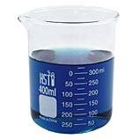
BEAKER
Used for measuring liquid roughly volume with low accuracy

Slide 21
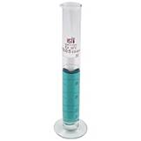
GRADUATED CYLINDER
Used for measuring liquid with better accuracy than beaker

Slide 22
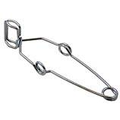
TEST TUBE HOLDER
Used for holding test tubes

Slide 23
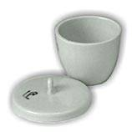
CRUCIBLE
Used for burning sample at high temperature

Slide 24
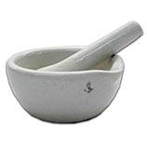
MORTAL AND PESTLE
Used for graining materials which have large particle size to small

Slide 25
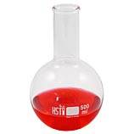
ROUND BOTTOM FLASK
Used for distillation or heating of liquid, allows uniform heating

Slide 26
VOLUMETRIC FLASK
Used for measuring liquid with high accuracy

Slide 27
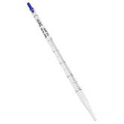
PIPETTE
Used to transfer exact amount of liquid

Slide 28
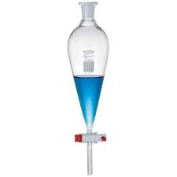
SEPARATORY FUNNEL
Used for Liquid-Liquid extracts, designed for increase separation efficiency

Slide 29
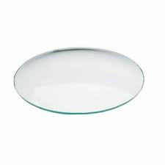
WATCH GLASS
Used for air drying or oven drying of liquid

Slide 30
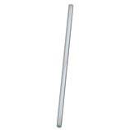
GLASS ROD
Used for stirring of liquid for several

Slide 31
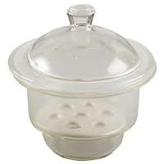
DESSICATOR
Used to store material and protect it from air contamination or humidity

Slide 32
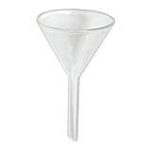
FUNNEL
Used for liquid transfer. Also for simple filtration

Slide 33
Condenser
Used for condensing volatile liquid during distillation

Slide 34
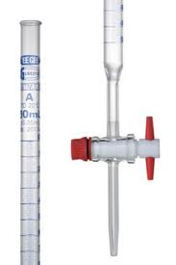
Burette
Used for titration where titrant pored inside

Slide 35
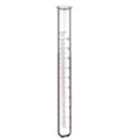
Test Tube
Used to hold and mix liquids.

Slide 36
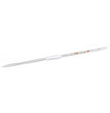
Volumetric Pipette
Used to measure small amounts of liquid very accurately. Never pipette by mouth! Use pipetting aids.

Slide 37
Cleaning
A detergent solution may be used to soak glassware. This removes grease and loosens most contamination.
Scrubbing with a brush or scouring pad is a mechanical means of removing gross contamination and large particles.
Sonicating the glassware in a hot detergent solution is an alternative to both a detergent solution and scrubbing.
Solvents, such as mild acids, known to dissolve a specific contamination may be used to remove trace quantities.

Slide 38
Glassware is often dried by suspending it upside down to drip dry on racks; these can include a hot air fan to blow the internals dry. Another alternative is to place the glassware under vacuum, lower the boiling points of the remaining volatiles.
Acetone may be used for a final rinse of sensitive or urgently needed glassware as the solvent is miscible with water, and helps dilute and wash away remaining water from the glassware.
Disposal
Typically broken glassware must be disposed of separately because shattered glass may be sharp.

Slide 39
Section cutting
Cross section: Here the section passes at right angle to the material. It is of two types.
i. Transverse Section: Here the section is cut at right angle to vertical axis of the plant such as stem and roots.
ii. Vertical section: In case of thallus, leaf, etc, the section is cut in transverse plane and is known as vertical section. It is generally applied to the dorsiventral leaf and thallus growing prostrate.
Longitudinal Section: The section is cut at right angles to the transverse axis. It is of two types.
i. Radial longitudinal section (R.L.S.). it is the section that passes through radius.
ii. Tangential Longitudianl section (T.L.S)
It is the section that passes through the tangent; this does not pass through central region, it is transverse to medullary ray.

Slide 40
FIRST AID
First Aid is the provision of immediate medical assistance to an ill or injured person until definitive medical treatment can be accessed, or until the illness or injury is fully dealt with.
It generally consists of a series of simple, potentially life-saving steps that an individual can be trained to perform with minimal equipment.

Slide 41
BASIC CONTENTS ARE:
Adhesive tape
Elastic wrap bandages
Bandage strips and "butterfly" bandages in assorted sizes
Nonstick sterile bandages and roller gauze in assorted sizes
Eye shield or pad
Triangular bandage
Aluminum finger split
Instant cold packs
Cotton balls and cotton-tipped swabs
Disposable nonlatex examination gloves, several pairs
Duct tape
Petroleum jelly or other lubricant
Plastic bags, assorted sizes
Safety pins in assorted sizes
Scissors and tweezers
Soap or hand sanitizer
Antibiotic ointment
Antiseptic solution and towelettes
Eyewash solution
Thermometer
Turkey baster or other bulb suction device for flushing wounds
Breathing barrier
Syringe, medicine cup or spoon
First-aid manual

Slide 42
Medications
Aloe vera gel
Calamine lotion
Anti-diarrhea medication
Laxative
Antacids
Antihistamine, such as diphenhydramine
Pain relievers, such as acetaminophen (Tylenol, others), ibuprofen (Advil, Motrin IB, others) and aspirin (never give aspirin to children)
Hydrocortisone cream
Cough and cold medications
Personal medications that don't need refrigeration
Auto-injector of epinephrine, if prescribed by your doctor

Slide 43
The principle of first aid is immediate action.
Any action taken needs to be careful and deliberate and the first-aider should remain calm at all times.
The first priority is to yourself and other bystanders.
Assess for danger and think before you act:
There may be gas - risk of explosion or asphyxiation
Electricity - the pool of water around the faulty washing machine may be live;
Fire - opening a hot door may be the last thing you should do;
Assault - the assailant with a knife or a gun may be behind the door awaiting their next victim or a hostage;
Blood - avoid unnecessary contact with bodily fluids by wearing gloves and a face shield if available.
It is important to assess the situation quickly, to appreciate the limitations of your own actions and to seek expert assistance.

Slide 44
ASSIGNMENT
Describe how you will carry out CPR

Slide 45
DISSECTION
Dissection (from Latin dissecare "to cut to pieces" also called anatomization, from Greek anatomia, from ana- "up" and temnein "to cut") is the process of disassembling and observing something to determine its internal structure and as an aid to discerning the functions and relationships of its components.
The term is most often used concerning the dissection of plants and animals, including humans. Human dissection is commonly practiced in the teaching of anatomy for students of medicine, while students of biology often engage in dissections of animals, but also of plants. Dissection is a medical practice utilized in pathology and forensic medicine during autopsy.
Vivisection is related to dissection, but it is done on living specimens.

Slide 46
CARE OF DISSECTION KIT
Safety Precautions
Handle scalpels, razor blades and other sharp instruments with care. Always cut away from the body and other people.
Do not use excessive force when working with or cleaning sharp instruments.
Always wear chemical splash goggles, chemical resistant gloves, and chemical resistant apron when working with preserved specimens.
Wash hands thoroughly with soap and water before leaving the laboratory.

Slide 47
How to help prevent rust
Rinse instruments and dissection pan after each use. Make sure to dry thoroughly either with a cloth or paper towel.
If the dissection pan contains rubber inserts, wash and dry them separately. Leaving the insert in the pan will harbour moisture and cause the pan to develop rust faster. Dry the pan on edge to allow the maximum surface area to be exposed to air.
Always remove scalpel blades at the end of each dissection unit and carefully dispose of in a sharps container.
Dispose of any instruments that are damaged and cannot be repaired.

Slide 48
Clean instruments with Alconox® (concentrated, anionic detergent for manual and ultrasonic cleaning) cleaning compound.
—Make cleaning detergent by mixing one teaspoon with one litre of water.
— Clean the instrument with a cloth or sponge wet with the cleaning detergent. The instrument can be submerged if necessary.
—Rinse with water and dry thoroughly according to the following instructions.
Drying instruments thoroughly is the single most important factor in preventing rust.
—Dry as completely as possible using towels or paper towels.
—If possible, allow a fan to circulate the air around the tools until each object is dried thoroughly.
— If a fan is not available, place instruments on a towel near a sunny window. Replace the towels when the items are turned over.
For long term storage, make sure instruments are completely dry and place them in a plastic bin with a desiccant such as silica gel packets.
For the best rust prevention, purchase instruments made with stainless steel or surgical steel. Although stainless steel instruments are initially more expensive, they tend to last longer before rusting.

Slide 49
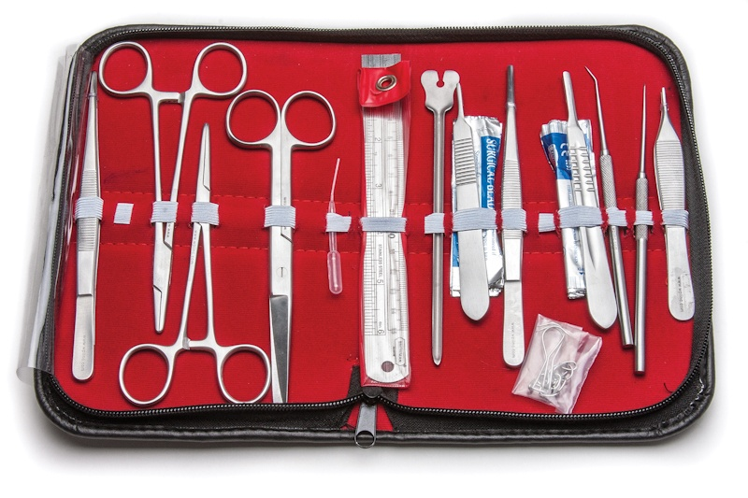
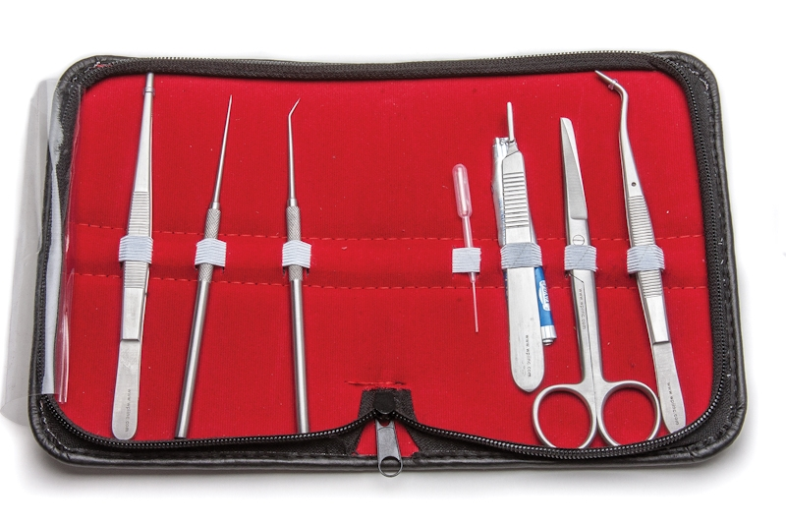
DISSECTING KIT FOR STUDENTS
STUDENT BOTANICAL KIT

Slide 50
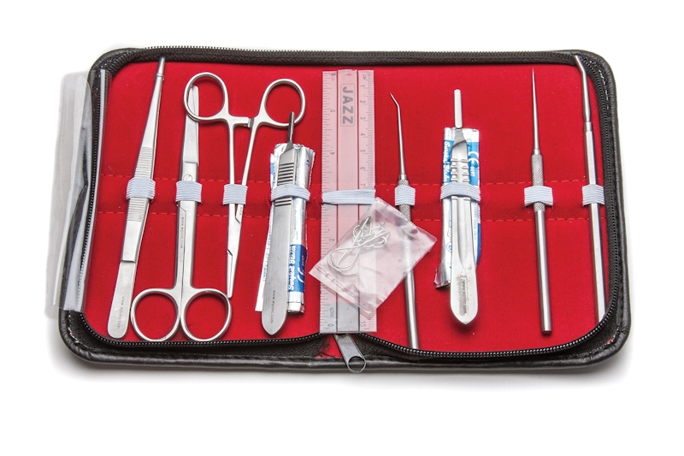
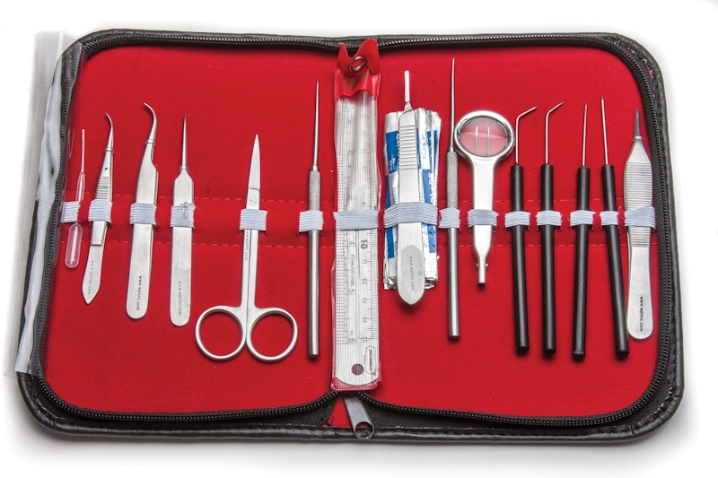
STUDENT ANATOMY KIT
ENTOMOLOGY KIT FOR STUDENTS

Slide 51
ASSIGNMENT
1.MAKE LARGE DIAGRAMS OF 5 (FIVE) NAMED DISSECTING TOOLS
2. State the functions of the each tool drawn

Slide 52
USE AND CARE OF THE MICROSCOPE

Slide 53
PARTS OF MICROSCOPE
1. Eyepiece/Ocular Lens – The lens into which the user looks to see the specimen. 2. Diopter Adjustment – Used to alter focus between eyepieces to 3. Arm – A supporting piece of the optical microscope mounted upon the base. 4. Nose Piece – A rotating turret for switching between objective lenses. 5. Objective Lenses – Lenses with various magnification strengths. 6. Slide Holder – Clips to keep the slide in place.

Slide 54
7. Stage – The platform holding the specimen slide. 8. Coarse Focus – Brings specimen into general focus. 9. Fine Focus – Fine tunes the focus of the specimen. 10. Condenser – Focuses light from the light source onto the specimen. 11. Iris Diaphragm – An opaque iris composed of blades made to pass light through an aperture. 12. Base – The supporting block of the light microscope. 13. Light Source – A light or a daylight directed via a mirror. 14. On/Off Switch – You probably understand what this does )

Slide 55
Handling the Microscope
1. Always use two hands to move the microscope. Place one hand around the arm, lift the scope, and then put your other hand under the base of the scope for support.
2. Be gentle. Setting the microscope down on the table roughly could jar lenses and other parts loose. The microscope seems like a simple instrument, but each lens (eyepiece and objective) is actually made up of a number of other lenses; banging your microscope around, shakes about 15 to 20 lenses
3. Always have clean hands when handling your microscope.

Slide 56
How would you carry the microscope? A or B

Slide 57
Storing the Microscope
1.Return the lowest power objective in place
2.Wrap the cord around the base
3. Dust is an enemy to microscope lenses; always keep the microscope covered when not in use

Slide 58
Cleaning the Microscope
1. Don’t let the microscope get too dirty – always use the dust cover when not in use.
2. To clean the eyepiece – use a high quality lens paper. First brush any visible dust from the lens, and then wipe the lens. Do not use facial tissues, they are made from ground up wood fibers and could damage the lenses.
3. To clean the objective lenses – use a fresh piece of the lens paper each time so that you don't transfer dust from one lens to another.
4. Use lens paper on all glass parts of the microscope.
5. Clean oil immersion lens with chemicals provided by your instructor

Slide 59
MICROMETRY/MEASURING OBJECTS UNDER THE MICROSCOPE
Micrometry is the science in which we have some measurement of the dimensions of an object being observed under the microscope.
The method employs some special types of measuring devices which are so oriented that these can well be attached to or put into the microscope and obser­ved. The object, to be measured, is calibrated against these scales.

Slide 60
Types of Micrometry:
There are usually two types of micrometers, i.e. stage micrometer and ocular meter or ocular micrometer

Slide 63
Stage Micrometer

